Slide 1
CHAPTER - 17
Data Communication and Computer Network

Slide 2
Data Communications
When we communicate, we are sharing information.
This sharing can be local or remote.
Between individuals, local communication usually occurs face to face, while remote communication takes place over distance.

Slide 3
Cont.
Data communications are the exchange of data between two devices via some form of transmission medium such as a wire cable.
  For data communications to occur, the communicating devices must be part of a communication system made up of a combination of hardware (physical equipment) and software (programs).

Slide 4
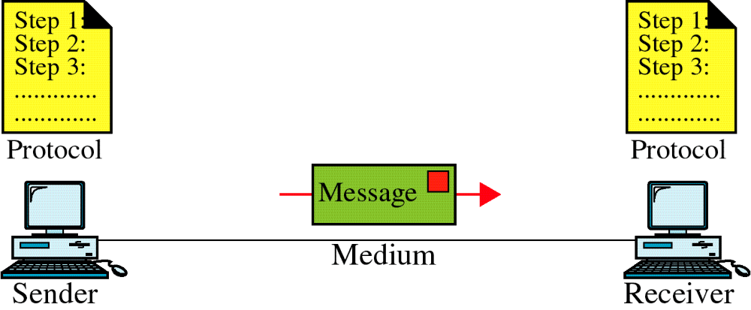
Components/Elements
A data communications system has five components.

Slide 5
Cont.
Message:
  The message is the information (data) to be communicated. Popular forms of information include text, numbers, pictures, audio, and video.
Sender:
  The sender is the device that sends the data message. It can be a computer, workstation, telephone handset, video camera, and so on.
Receiver:
  The receiver is the device that receives the message. It can be a computer, workstation, telephone handset, television, and so on.

Slide 6
Cont.
Transmission medium:
  The transmission medium is the physical path by which a message travels from sender to receiver. Some examples of transmission media include twisted-pair wire, coaxial cable, fiber-optic cable, and radio waves.
Protocol:
  A protocol is a set of rules that govern data communications. It represents an agreement between the communicating devices. Without a protocol, two devices may be connected but not communicating, just as a person speaking French cannot be understood by a person who speaks only Japanese.

Slide 7
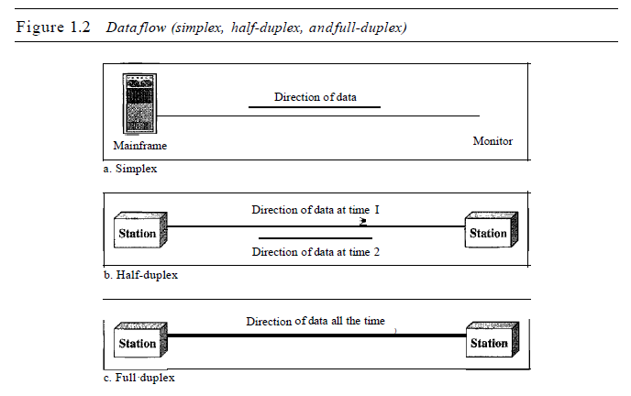
Data Transmission Model
Communication between two devices can be simplex, half-duplex, or full-duplex.

Slide 8
Simplex
In simplex mode, the communication is unidirectional, as on a one-way street. Only one of the two devices on a link can transmit; the other can only receive.
  Keyboards and traditional monitors are examples of simplex devices. The keyboard can only introduce input; the monitor can only accept output.

Slide 9
Half-Duplex
In half-duplex mode, each station can both transmit and receive, but not at the same time. When one device is sending, the other can only receive, and vice versa.
The half-duplex mode is like a one-lane road with traffic allowed in both directions. When cars are traveling in one direction, cars going the other way must wait.
  For example, Walkie-talkies and CB (citizens band) radios are both half-duplex systems.

Slide 10
Full-Duplex
In full-duplex mode (also called duplex), both stations can transmit and receive simultaneously.
The full-duplex mode is like a two-way street with traffic flowing in both directions at the same time.
  One common example of full-duplex communication is the telephone network. When two people are communicating by a telephone line, both can talk and listen at the same time.

Slide 11
Data Transmission Speed
Data transmission speed is the rate of transferring data from source to destination. It is also referred as Bandwidth.
Unit of bandwidth is Bit Per Second or bps or baud.

Slide 12
Bandwidth
One characteristic that measures network performance is bandwidth. However, the term can be used in two different contexts with two different measuring values:
  Bandwidth in hertz.
  Bandwidth in bits per second.

Slide 13
Cont.
Bandwidth in Hertz:
Bandwidth in hertz is the range of frequencies contained in a composite signal or the range of frequencies a channel can pass.
  For example, we can say the bandwidth of a subscriber telephone line is 4 kHz.
Bandwidth in Bits per Seconds:
The term bandwidth can also refer to the number of bits per second that a channel, a link, or even a network can transmit.
  For example, one can say the bandwidth of a Fast Ethernet network (or the links in this network) is a maximum of 100 Mbps. This means that this network can send 100 Mbps.

Slide 14
Throughput
The throughput is a measure of how fast we can actually send data through a network.
Although, at first glance, bandwidth in bits per second and throughput seem the same, they are different.
A link may have a bandwidth of B bps, but we can only send T bps through this link with T always less than B.

Slide 15
Cont.
The bandwidth is a potential measurement of a link; the throughput is an actual measurement of how fast we can send data.
  For example, we may have a link with a bandwidth of 1 Mbps, but the devices connected to the end of the link may handle only 200 kbps. This means that we cannot send more than 200 kbps through this link.

Slide 16

Example
A network with bandwidth of 10 Mbps can pass only an average of 12,000 frames per minute with each frame carrying an average of 10,000 bits. What is the throughput of this network?
Solution
We can calculate the throughput as
The throughput is almost one-fifth of the bandwidth in this case.

Slide 17
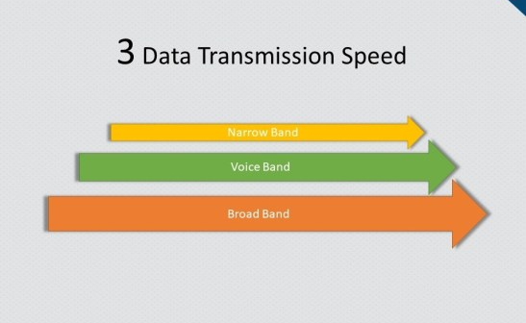
Data Transmission Speed Category
There are 3 types of Bands which are as follows
  (1). Narrow Band
  (2). Voice Band
  (3). Broad Band

Slide 18
Cont.
Narrow Band
Speed or bandwidth of this band can be 45bps to 300bps in general. Data transmission in narrow band is called sub-voice band. This band is used in slow data transmission. Narrow band is used in telegraphy. In telegraphy, use of more cable slows down the speed.
Voice Band
Speed of this band can be up to 9600bps. This band is mostly used in telephone communication. Also in computer, this band is used in transferring data from computer to printer or card reader to computer.

Slide 19
Cont.
Broad Band
Broad band is ideal for very high speed data transmission where the minimum data transmission speed can be 1Mbps (Mega bits per second) and reach up to a few giga bits per second. This band is used in data transmission through coaxial cable and optical fiber cable. Beside these, board band is also used in satellite and microwave communication.

Slide 20
How to Calculate Data Transfer Rate
You might want to know the transfer rate if you’re downloading something online or transferring data from one source to another.
  First, convert your units, so the file size and transfer speed are in either bits or bytes with the same prefix (kilo, Mega, Giga, or Tera).
  Then, plug your numbers into the equation
    S = A ÷ T, in which
      A = The amount of data
      T is = The transfer time
      S, = The transfer speed or rate.

Slide 21
Cont.
File sizes may be given in bits (b), bytes (B), Kilobytes (KB), Megabytes (MB), Gigabytes (GB), or even Terabytes (TB). Pay attention to whether the letters are upper case or lower case as well. For instance, a bit is denoted with a lowercase "b" while a byte is denoted with an uppercase "B".
Transfer speeds might be provided in bits per second (bps), bytes per second (B/s), Kilobytes per second (KB/s), Megabytes per second (MB/s), or Gigabytes per second (GB/s).

Slide 22
Example
You might have transferred 25 MB in 2 minutes.
First, convert 2 minutes to seconds by multiplying 2 by 60, which is 120.
S = A ÷ T
S = 25 MB ÷ 120 seconds.
= 25 ÷ 120 = 0.208.
Therefore, the transfer speed is 0.208 MB/s.
  If you want to turn this into Kilobytes, multiply 0.208 by 1024. 0.208 x 1024 = 212.9.
  So, the transfer speed is also equal to 212.9 KB/s.

Slide 23
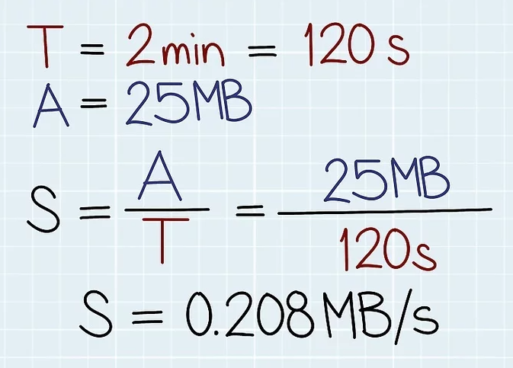
Cont.

Slide 24
Cont.
For instance, say you transferred 134 GB at a rate of 7 MB/s.
First, convert GB to MB so you’re working with the same units in each part of the equation. 134 x 1,024 = 137,217. So, you transferred 137,217 MB at a rate of 7 MB/s.
S = A ÷ T or T = A ÷ S = 137,217 ÷ 7 =19,602 s
To convert this to hours, divide by 3,600, which is 5.445. In other words, it took 5.445 hours to transfer 134 GB at a rate of 7 MB/s.
  If you want to use hours and minutes, separate out the whole number and decimal: you have 5 hours and 0.445 hours. To convert 0.445 hours to minutes, multiply by 60. 0.445 x 60 = 26.7. To convert the decimal into seconds, multiply it by 60. 0.7 x 60 = 42. Altogether, it took 5 hours, 26 minutes, and 42 seconds.

Slide 25
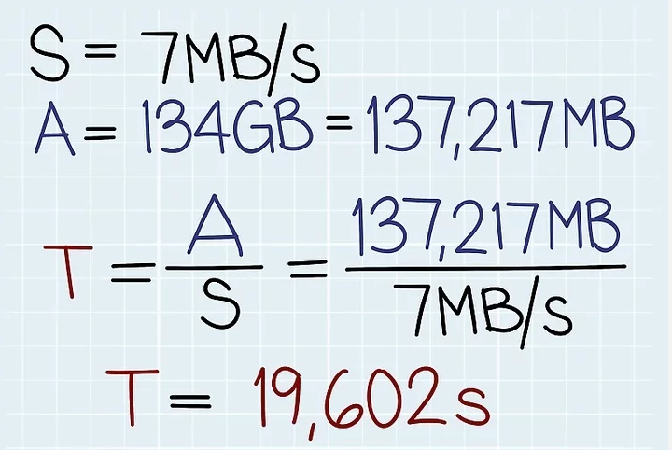
Cont.

Slide 26
Cont.
For example, you can figure out how much data was transferred in 1.5 hours at a rate of 200 bps.
First, convert hours to seconds by multiplying by 1.5 by 3,600, which is 5,400. So, A = T x S, A = 5,400 seconds x 200 bps. A = 1,080,000 bps.
To convert to bytes, divide by 8. 1,080,000 ÷ 8 = 135,000. To convert to Kilobytes, divide by 1,024. 135,000 ÷ 1,024 = 131.84. Therefore, 131.84 KB of data was transferred in 1.5 hours at a rate of 200 bps.

Slide 27
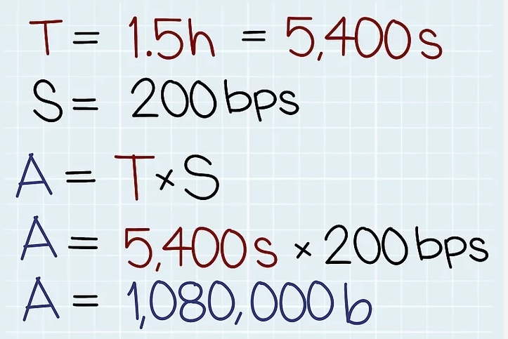
Cont.

Slide 28

Data Transmission Media
A transmission medium can be broadly defined as anything that can carry information from a source to a destination.
The transmission medium is usually free space (air, vacuum, and water), metallic cable, or fiber-optic cable.

Slide 29
Cont.
The most commonly used ones are:
  Twisted-pair wire (UTP cable)
  Coaxial cable
  Microwave system
  Communications satellite
  Optical fibers

Slide 30
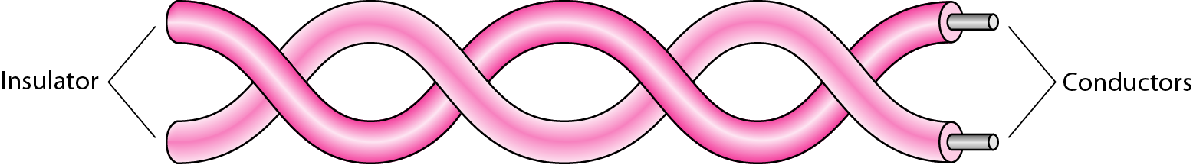
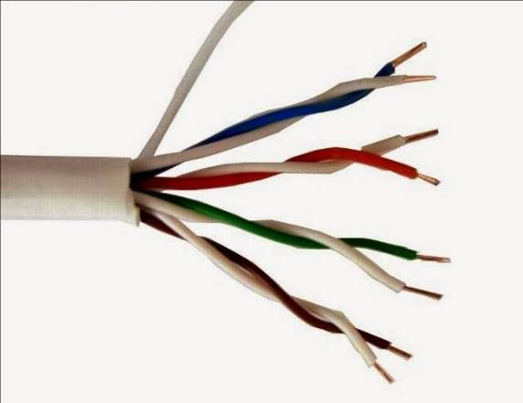
Twisted-Pair Cable
A twisted pair consists of two conductors (normally copper), each with its own plastic insulation, twisted together.

Slide 31
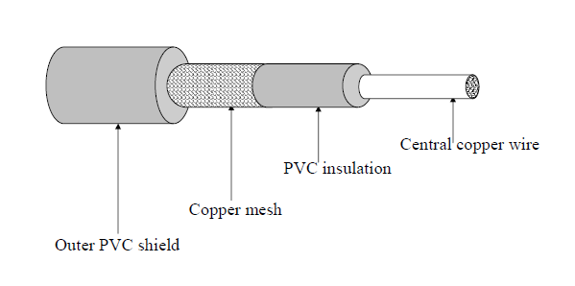
Coaxial Cable
Coaxial Cables consist of a central copper wire surrounded by a PVC insulation over which there is a sleeve of copper mesh. The copper mesh sleeve is shielded again by an outer shield of thick PVC material. Signal is transmitted by inner copper wire, and is electrically shielded by outer copper mesh sleeve.

Slide 32
Microwave System
Microwave Systems use very high frequency radio signals to transmit data through space (wireless communication).
However, at microwave frequencies, electromagnetic waves cannot pass obstacles like tall buildings or hills.
Hence, transmitter and receiver of a microwave system, mounted on very high towers, should be in line-of-sight (They have a direct view of each other with no obstacles in between).
This may not be possible for very long distance transmission.
Microwave, signals become weaker after traveling a certain distance and require power amplification.

Slide 33
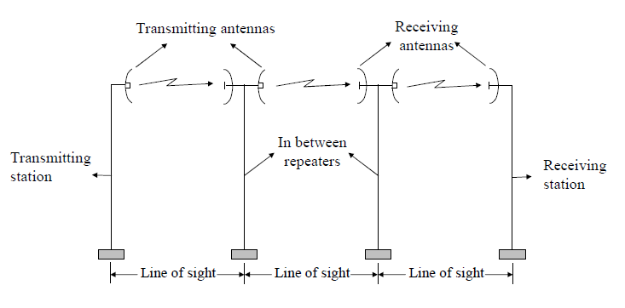
Cont.

Slide 34
Communications satellite
Main problem with microwave communication is that curvature of earth, mountains, and other structures often block the line-of-sight. Hence, long distance transmission requires several repeater stations, increasing data transmission cost between two points. Satellite overcome this problem.
A communications satellite is a type of artificial satellite that is placed in Earth’s orbit for the purpose of sending and receiving communication data between a source and destination. It is used to provide data communication and relaying services for televisions, radio, telecommunication, weather and Internet services.

Slide 35
Cont.
In satellite communication, microwave signal at 6 GHz or 14 GHz is transmitted from a transmitter on earth to a satellite positioned in space.
By the time this signal reaches the satellite, it becomes weak due to 36,000 kms travel .
A transponder, mounted on the satellite, amplifies the weak signal and transmits it back to the earth at a frequency of 4 GHz or 11 GHz.
A receiving station on the earth receives this signal.

Slide 36
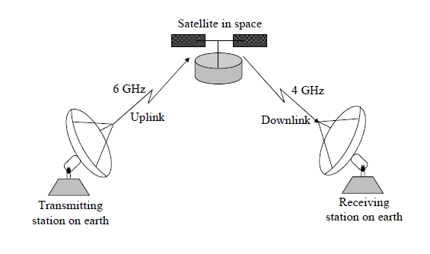
Cont.

Slide 37
Advantages and disadvantages of satellite communications
H.W

Slide 38
Optical Fibers
Optical fibers are hair-thin threads of glass or plastic used as data transmission medium like copper wires or coaxial cables.
However, unlike copper wires or coaxial cables, they transmit light signals instead of signals.
As light travels much faster than electricity, optical fibers can transmit data at much higher speed than copper wires or coaxial cables with no significant loss of intensity over long distances.

Slide 39
Cont.
The sender side electrical-to-light-wave converter converts electrical signals into light signals. It uses either a light-emitting diode (LED) or a laser diode to convert electric signals into light signals. It then transmits these light waves over the optical fiber to receiver's end.
The receiver side light-to-electrical-wave converter detects the light waves and converts them back to electrical signals. It uses photoelectric diodes for this purpose.
An amplifier then amplifies and sends tit electrical signals to the receiver.

Slide 40
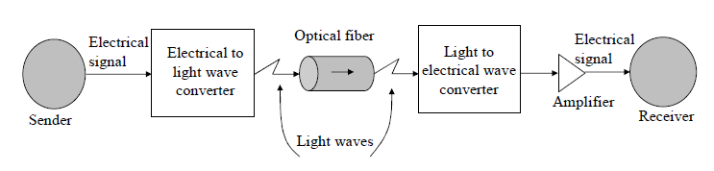
Cont.

Slide 41
Advantages and disadvantages of Optical Fibers
H.W

Slide 42

K. M. Aslam Uddin
Assistant Professor (ICE)
Noakhali Science and Technology University

